Slide 1
Prophetic Word from Pastor Joseph
27th November 2011 Midnight
There is no limit to how much God can use a person or a group of people who can receive support, correction, praise and persecution with the same gracious spirit.

Slide 2
Growing In Stature
Aligning Our Vision
Adrian Liew
29/04/2018

Slide 3

The way you think shapes the way you view things

Slide 4
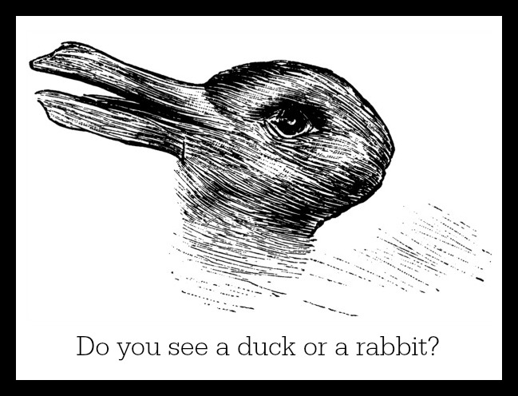
The way you think shapes the way you view things

Slide 5
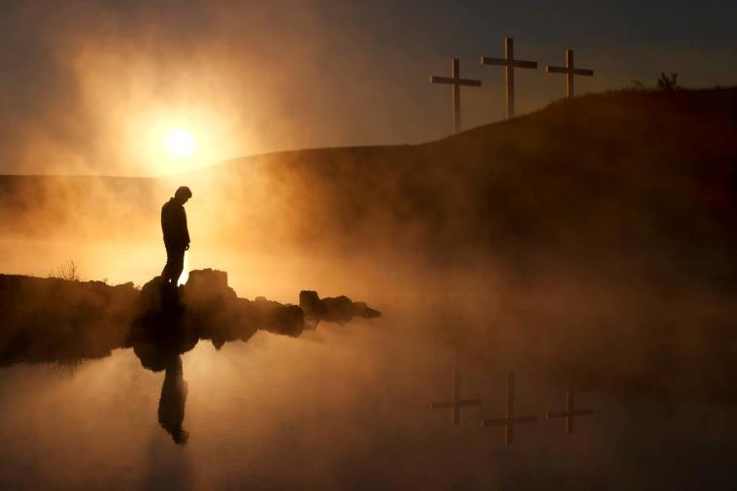
The way you think shapes the way you view things

Slide 6
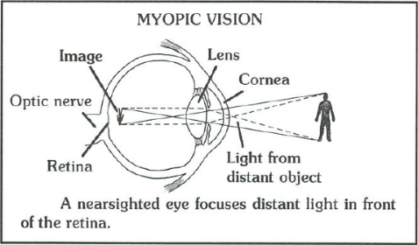
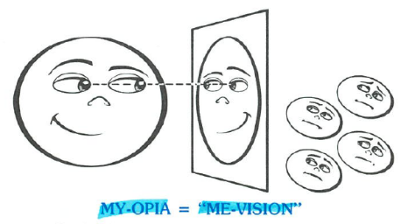
5 Types of Spiritual Eye Conditions
1) Me-Vision (Myopia/Nearsighted Vision)
Natural: The inability of the eye to focus on distant objects
Spiritual: Focusing on things that ONLY affect ME

Slide 7
5 Types of Spiritual Eye Conditions
1) Me-Vision (Myopia/Nearsighted Vision)
Philippians 2:21
For everyone looks out for their own interests, not those of Jesus Christ

Slide 8
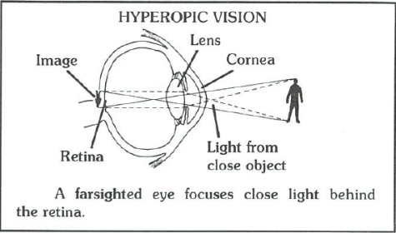
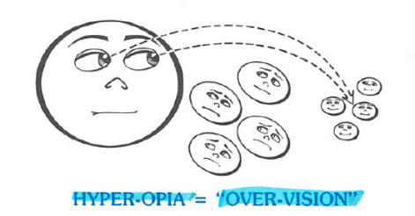
5 Types of Spiritual Eye Conditions
2) Over-Vision (Hyperopia/Farsighted Vision)
Natural: The inability of the eye to focus on close objects
Spiritual: When we overlook the needs of those who are close to us, especially our own family members.

Slide 9
5 Types of Spiritual Eye Conditions
2) Over-Vision (Hyperopia/Farsighted Vision)
1 Timothy 5:8
Anyone who does not provide for their relatives, and especially for their own household, has denied the faith and is worse than an unbeliever

Slide 10
5 Types of Spiritual Eye Conditions
2) Over-Vision (Hyperopia/Farsighted Vision)
Matt 7:3-5
3 “Why do you look at the speck of sawdust in your brother’s eye and pay no attention to the plank in your own eye? 4 How can you say to your brother, ‘Let me take the speck out of your eye,’ when all the time there is a plank in your own eye? 5 You hypocrite, first take the plank out of your own eye, and then you will see clearly to remove the speck from your brother’s eye

Slide 11
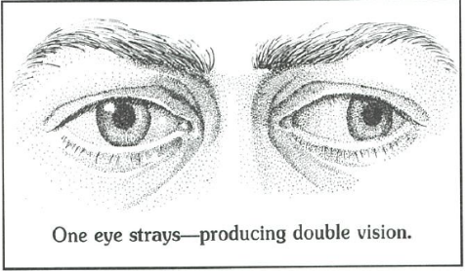

5 Types of Spiritual Eye Conditions
3) Straying Vision (Stabismus/Lazy Eye Vision)
Natural: Condition in which the eyes do not focus on the same object at the same time
Spiritual: When we have one eye focused on the Lord and one eye focused on the world

Slide 12
5 Types of Spiritual Eye Conditions
3) Straying Vision (Stabismus/Lazy Eye Vision)
Proverbs 4:25-27
25 Let your eyes look straight ahead; fix your gaze directly before you.
26 Give careful thought to the paths for your feet and be steadfast in all your ways.
27 Do not turn to the right or the left; keep your foot from evil.

Slide 13
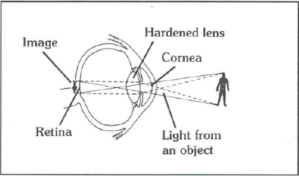
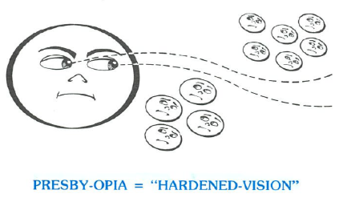
5 Types of Spiritual Eye Conditions
4) Hardened Vision (Presbyopia/Nearsighted and Farsighted Vision)
Natural: The condition of a hardened lens which loses its elasticity over time
Spiritual: Christians who start the race well, but later become hard and resistant to God’s promptings and end up not finishing the race well

Slide 14
5 Types of Spiritual Eye Conditions
4) Hardened Vision (Presbyopia/Nearsighted and Farsighted Vision)
1 John 3:16-18
16 This is how we know what love is: Jesus Christ laid down his life for us. And we ought to lay down our lives for our brothers and sisters. 17 If anyone has material possessions and sees a brother or sister in need but has no pity on them, how can the love of God be in that person? 18 Dear children, let us not love with words or speech but with actions and in truth.

Slide 15
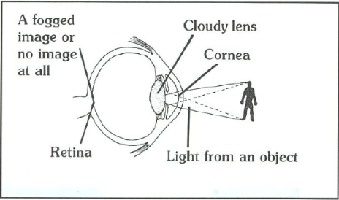
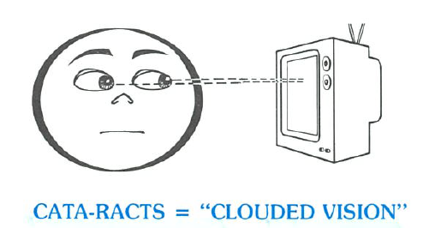
5 Types of Spiritual Eye Conditions
5) Clouded Vision (Cataracts/Blocked Vision)
Natural: The condition of a cloudy lens which blocks the light passing through to the retina
Spiritual: When we set our eyes on the evil that’s in the world, our eyes become clouded.

Slide 16
DECLARATION
“I refuse to be under
The direction of this body
I speak to my eyes, my nose, my ears, my mouth, my mind
Come under the discipline of the Holy Ghost!
He is the Lord and Giver of life!
I command my soul to agree with God!
My intellect, my reason and my emotions
Agree with God!”

